Slide 1
Zillow Rent Index, Nov 2010 - Jan 2017
Team Members:
Shunfang Lan 001027261
Meinan Wang 001386565
Xintong Zhao 001305075
Xinyue Zhang 001388905

Slide 2
Contents
Exploring the Data Set
Overall Data Analysis and Visualisation
LSTM RNN Prediction

Slide 3
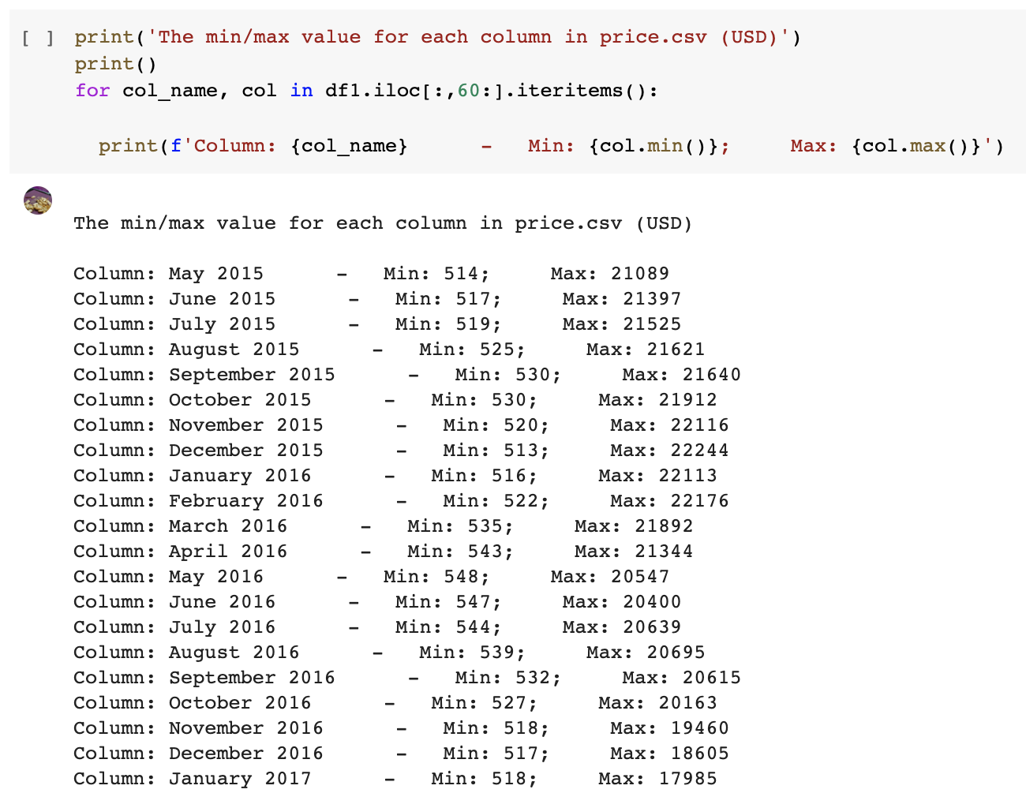
Exploring the Data Set
-- Max and min values
We look into the entire “Price.csv” data set and find out the max/min rental pricing from May 2015 to Jan 2017.
The output indicates the gap between the city with lowest rental listing and the city with highest rental listing in each month.

Slide 4
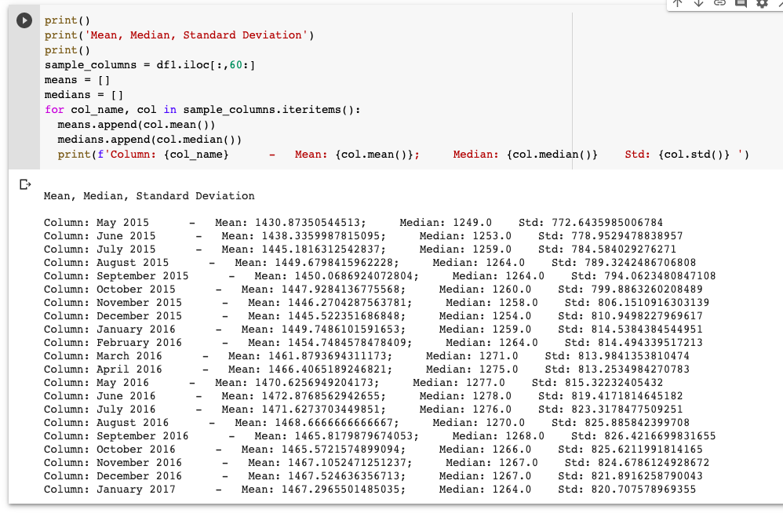
Exploring the Data Set
-- Mean, median and standard deviation values
We also reveal the data skewness with mean, median and standard deviation

Slide 5
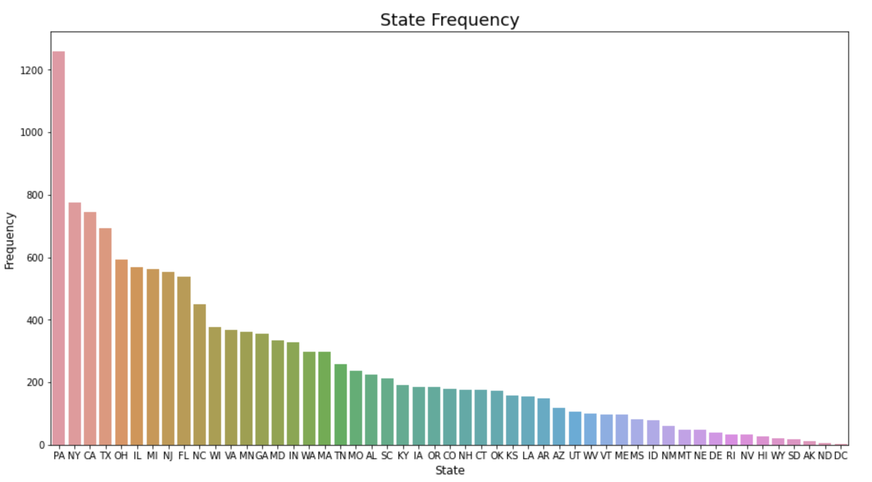
Overall Data Analysis and Visualisation
-- Number of cities for all states
This histogram presents the number of cities in each state of the US.
PA has the largest number of reported cities among all states, over 1200.
While DC has the smallest.

Slide 6
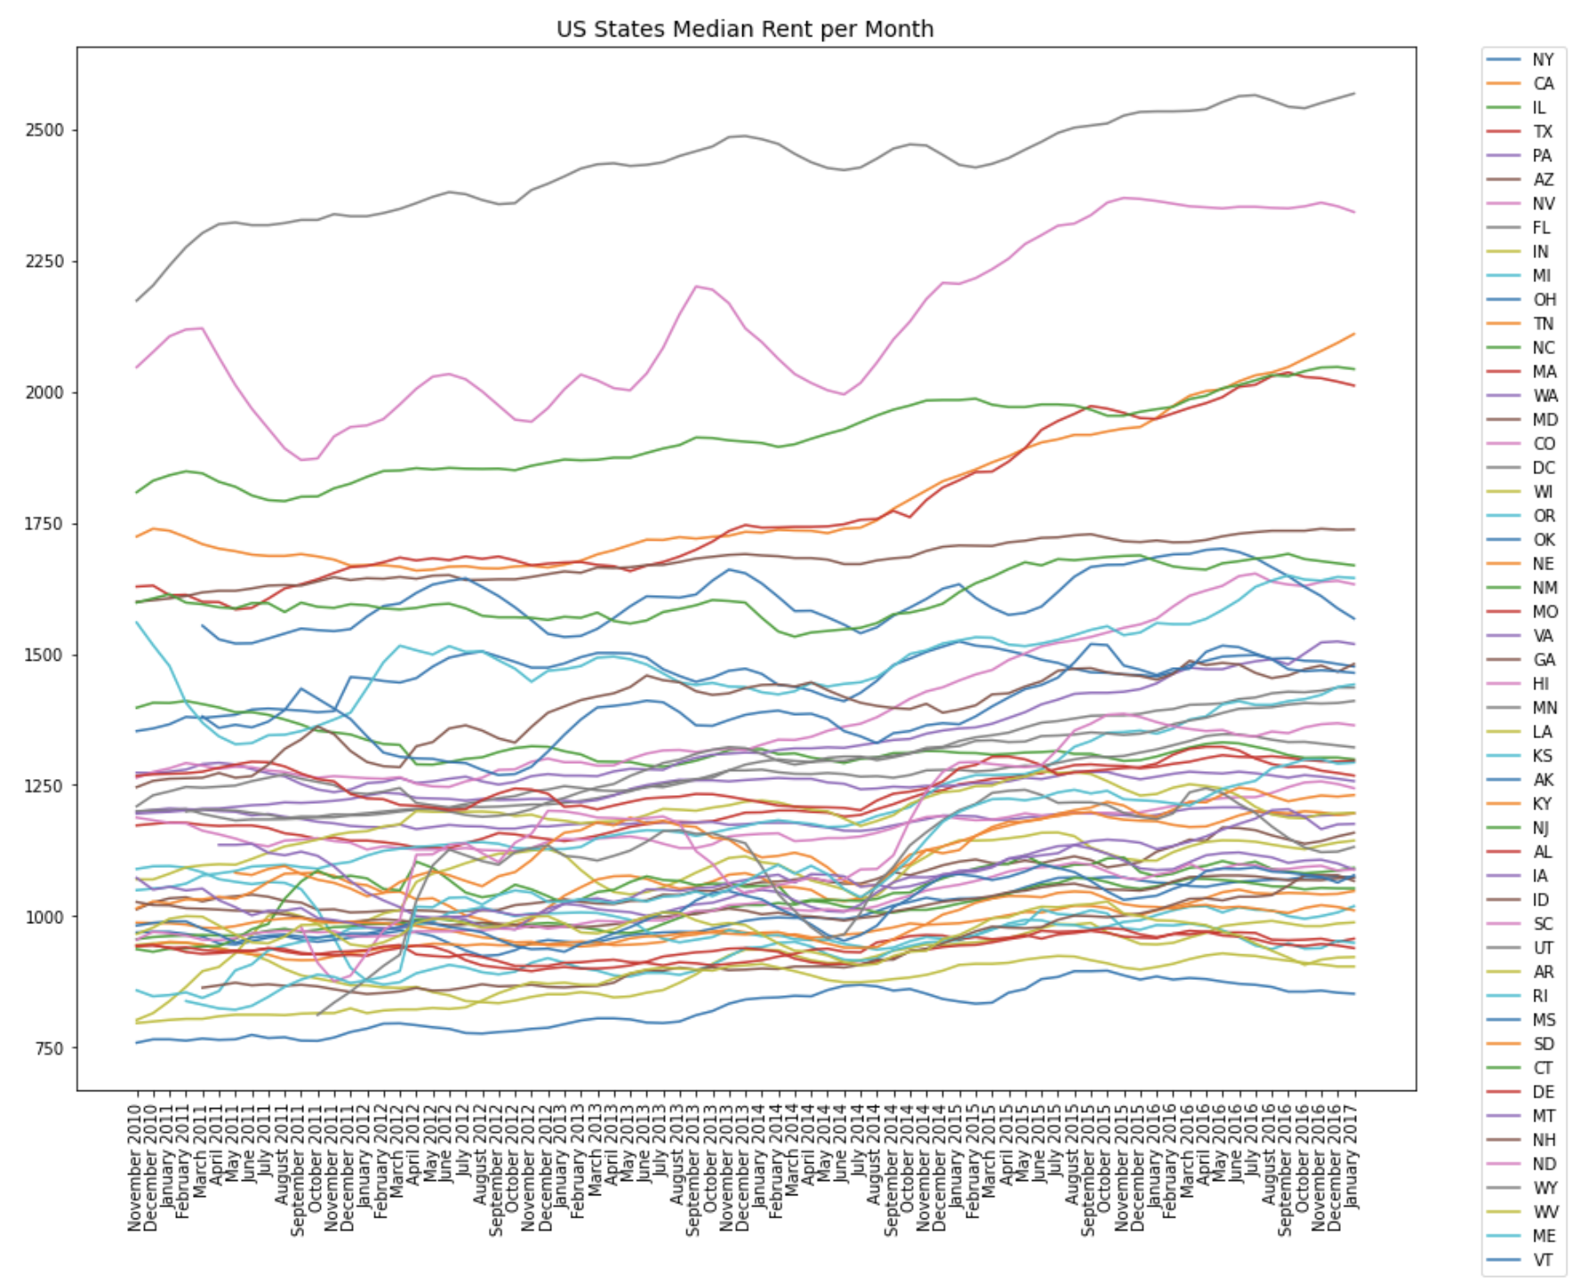
Overall Data Analysis and Visualisation
-- Median rental listing for all states per month
This line chart presents the median rental listing per month for all states.
Washington DC has the highest median rental listing, following by Hawaii at the second place.
California has a steady increase trend, making it the third place in January 2017 of all states.

Slide 7
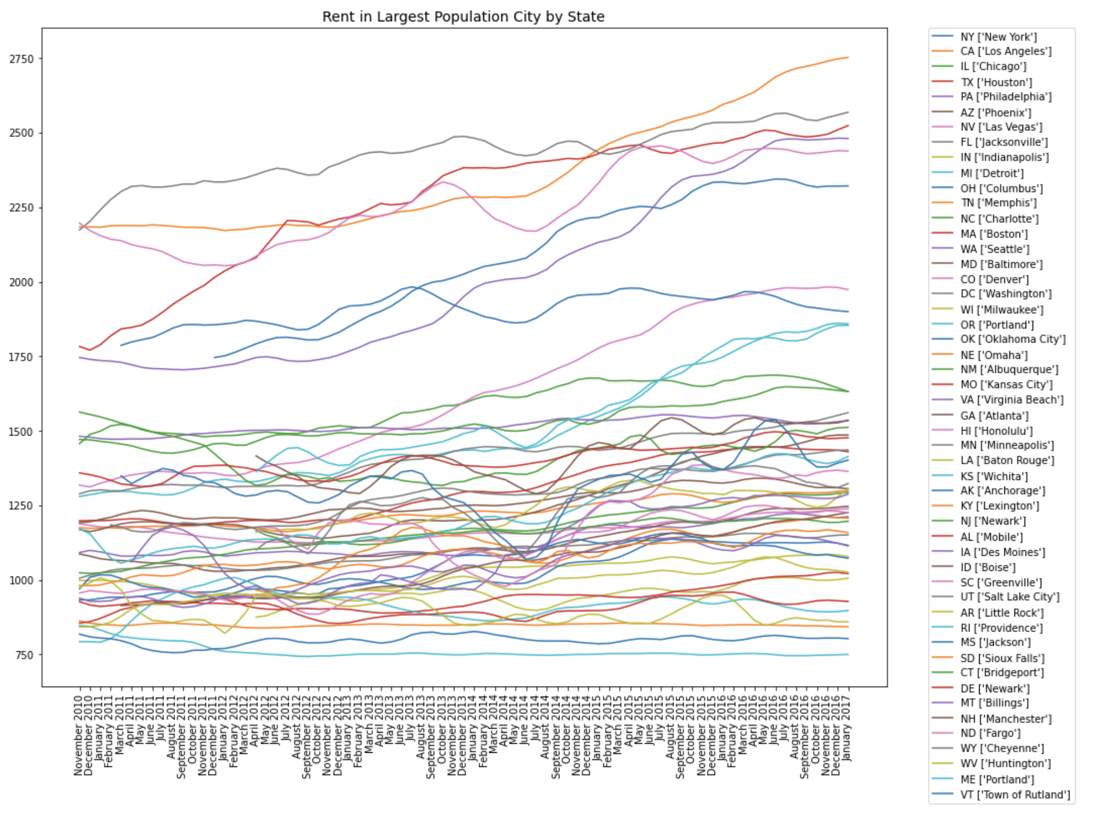
Overall Data Analysis and Visualisation
-- Rental listings of cities with the largest populations in all states
Los Angeles in California has the highest rental listing among all large cities in January 2017. It shows a steady increase trend during the data collection period.
Washington, D.C. ranked first in this chart before it was surpassed by Los Angeles in January 2015.

Slide 8
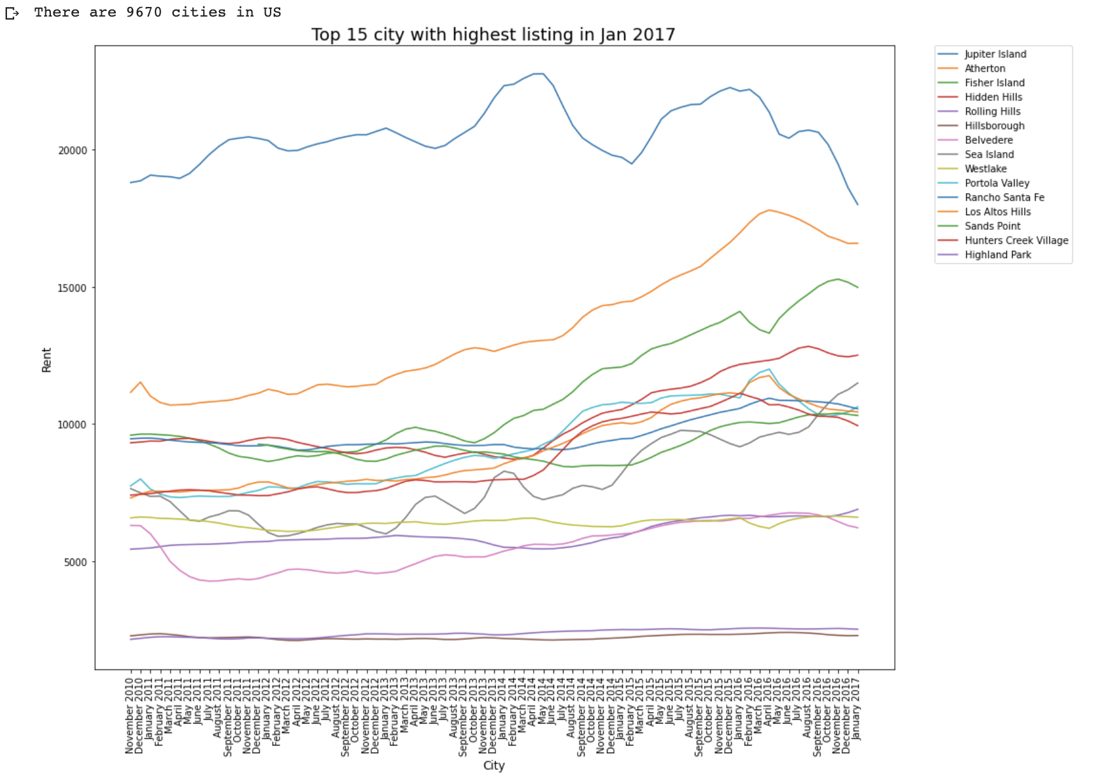
Overall Data Analysis and Visualisation
-- Top 15 cities with highest rental listing in Jan 2017
This line chart presents top 15 cities, out of 9670 unique cities in the US, with the highest listing in Jan 2017 and their past pricing curves.
Jupiter Island has the highest listing since Nov. 2010. The listing price became fluctuating from 2013 to 2017.
Atherton in Bay Area shows a steady increase till mid- 2016.
Rental listing in Hunter Creek Village and Highland Park barely fluctuated during the data collection period.

Slide 9
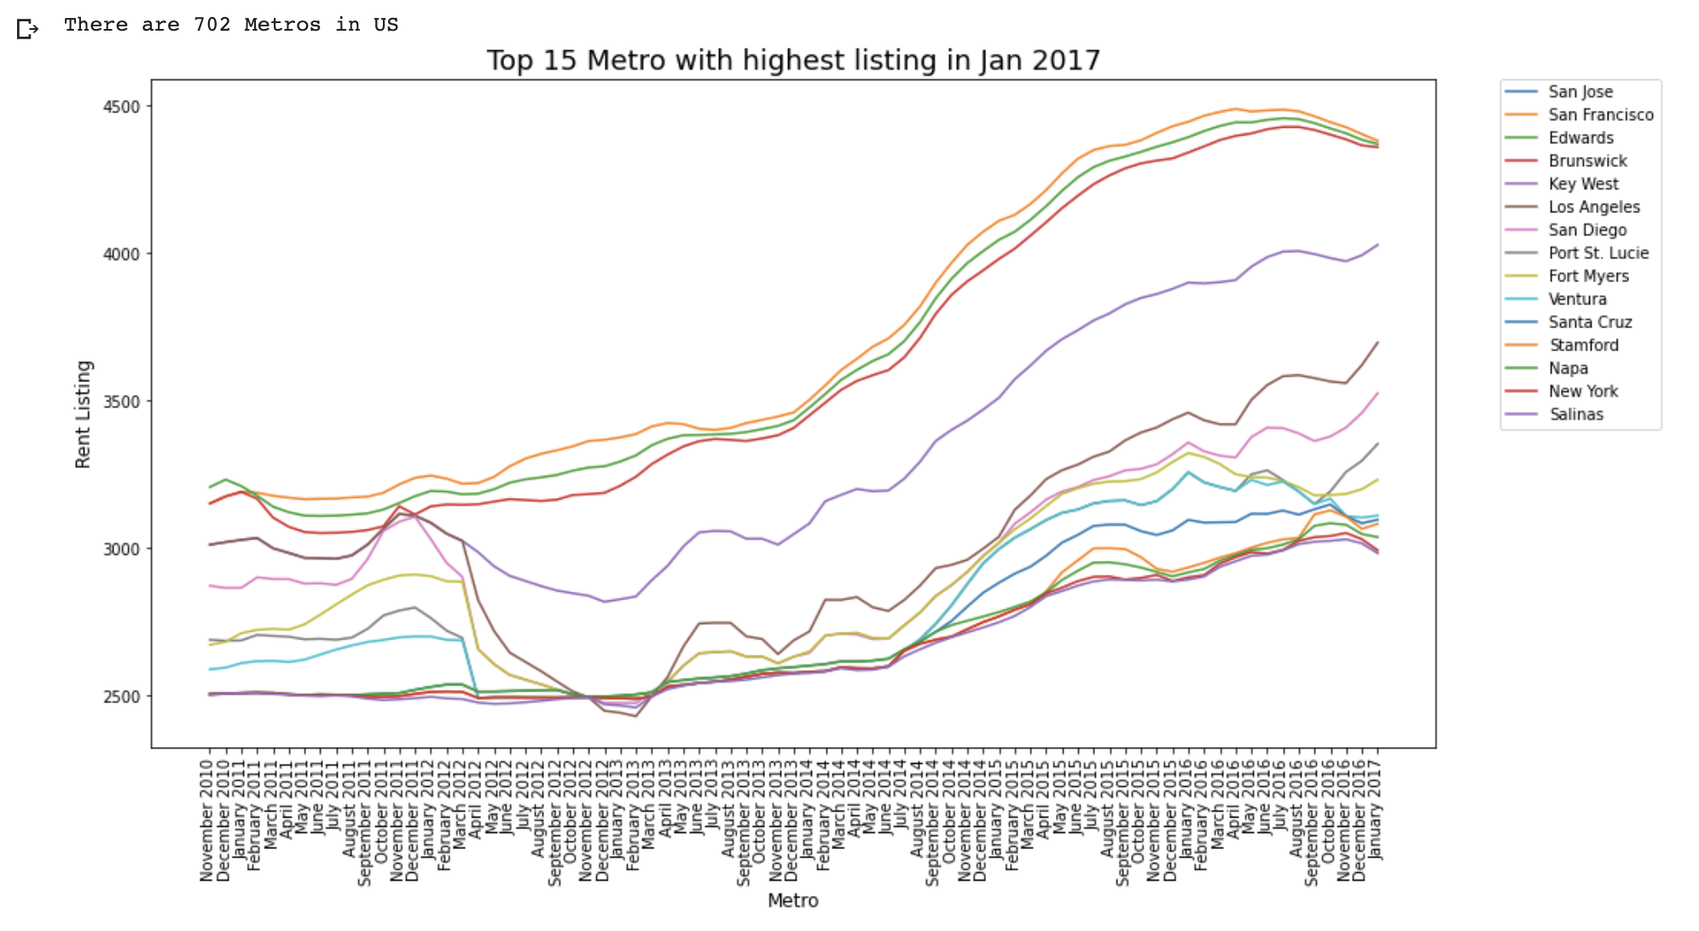
Overall Data Analysis and Visualisation
-- Top 15 metro with highest rental listing in Jan 2017
This line chart presents top 15 metro, out of 702 unique metro in the US, with highest listing in Jan. 2017 and their past listing curves.
San Jose and San Francisco in California have the top 2 highest listings during the data collection period, followed by Edwards in Colorado as the third place.
Surprisingly NY is not in the top 10 places, but it shows a steady increasing trend.

Slide 10
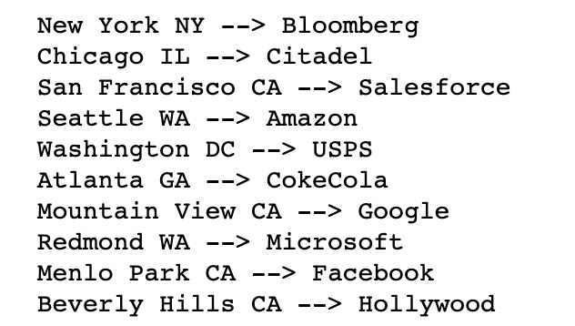
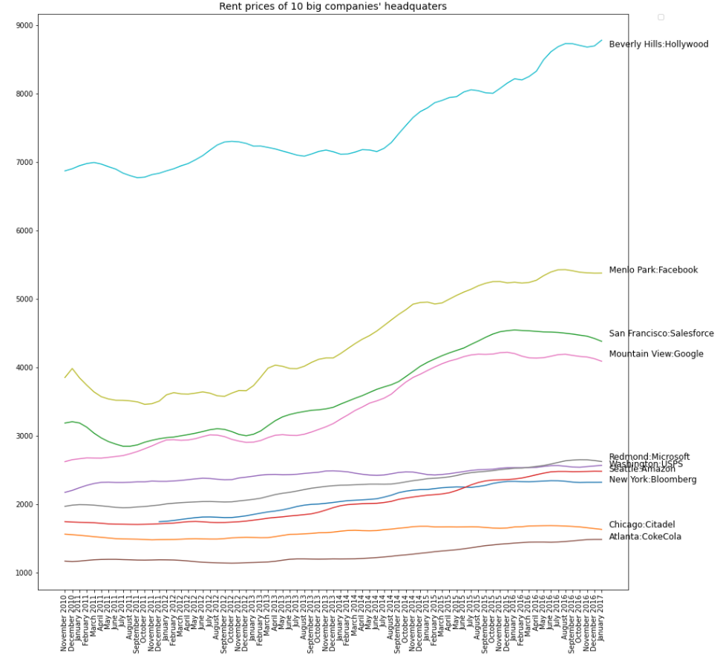
Overall Data Analysis and Visualisation
-- Rental Listing of Headquarter cities of 10 Major Companies
Beverly Hills has the most expensive rental listing among the 10 cities.
Other 3 Californian cities (SF, MTV and MPK) follow and have a major increase from 2015 to 2017. The prices of Seattle, Redmond, Washington and NY's almost stay the same.
Chicago has relatively low rental listing and Atlanta's rental listing is the lowest.
SF and MTV's prices have the trend to decrease while Beverly Hills does not.¶

Slide 11
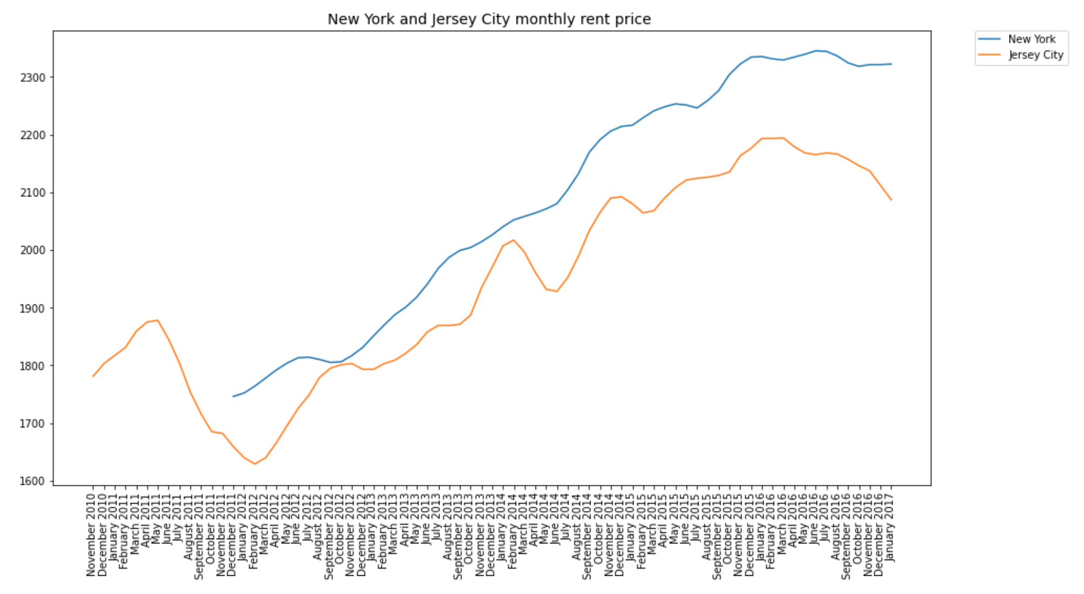
Comparison between two adjacent cities
-- New York and New Jersey in price
New York’s monthly rental listing is higher than Jersey City’s.
The listing of Jersey city started to decrease from 2016, while price of New York stayed steady.

Slide 12
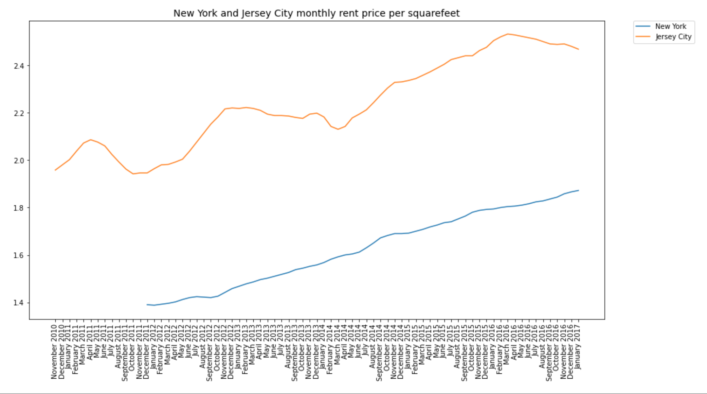
Comparison between two adjacent cities
-- New York and New Jersey in price per sqft
Although these two cities are located closely, the rental listing per sqft are much different.
Jersey City’s price is much higher than New York’s.
Thus with the same budget, an entity could get a much bigger house in New York than in Jersey City.

Slide 13
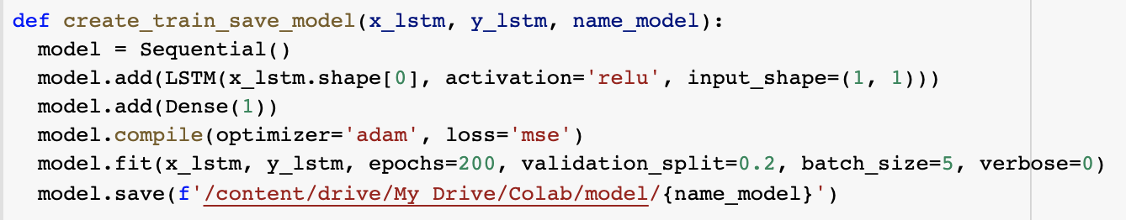
LSTM RNN time series prediction
-- Modeling
The ZRI is a time series price listing
LSTM is a general neural network candidate to model and predict this type of time series
We converted the CSV file into a LSTM standard input and train a small model per city
The small models are used to predict the prices in the coming month for each city

Slide 14
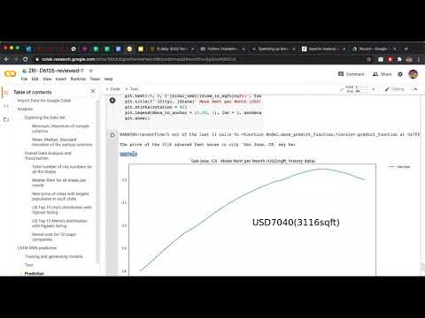

Slide 15
Thanks!

